Slide 1
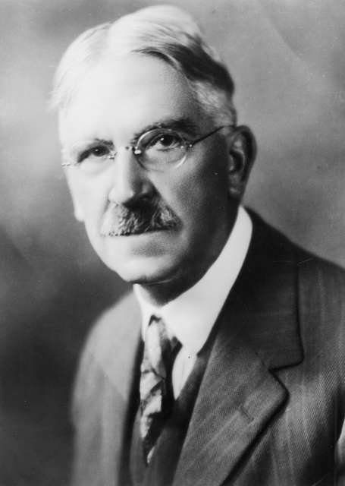
E - Learning Module
PREPARING DEBRIEFING PROCESS
"We do not learn from experience... we learn from reflecting on experience." John Dewey
John Dewey, american philosopher and educator who believed that each child was active, inquisitive and wanted to explore.

Slide 2
E - Learning Module
Importance of debriefing
Debriefing is crucial because it helps learners explore.
What went on.
Talk about their experiences.
Develop insights.
Reduce negative feelings about aspects of the activity.
Connect the activities to their real-life situations.

Slide 3
E - Learning Module
Importance of debriefing
There are a lot different debriefing models to adapt but the most important concepts are:
having the learner describe what happened,
asking them to analyze their performance,
and encouraging them to talk about how this experience could be applied to the real world.

Slide 4
E - Learning Module
Feelings
How do you feel now?
How did you feel while being locked?
How did you feel first, when you entered the room?
What made you to feel relieved/stressed?

Slide 5
E - Learning Module
Fact
What did you do?
First.. Next.. Then.. and Finally...
Tell your friends what you did and convince them to participate in the game.

Slide 6
E - Learning Module
Learning
What did you learn?
Did you find out anything interesting to share?

Slide 7
E - Learning Module
Real life bond
Have you done the puzzles similar to ES before?
Have you ever had to solve a real-life problem on your own?
What skills did you need to solve the problem?
Have you ever been locked in a room?

Slide 8
E - Learning Module
Real life bond
How did you get out?
Have you ever wondered how things are made?
Have you ever lost anything and how did you find that?
What strategies if any did you apply while seeking the thing lost?

Slide 9
E - Learning Module
Future
What would you do differently?
If you play the game similar to the ER, what will you change in your behavior/strategy?
Are you planning to use the strategies in your Science/Math classes?

Slide 10
E - Learning Module
Summary
A well planned and thoroughly thought out debriefing process will contribute to better learning results and a pleasure of learning.

