Slide 1
GRAIN 3
Managing the game difficulty

Slide 2

Balance the difficulty
Scale the difficulty of puzzles for different levels of students
or
Label the difficulty as easy, medium, hard and extreme mode, and allow your students to select what they would like to try
https://www.mobileescapes.ca/escape-room

Slide 3
Number of participants
Divide participants in groups according to available time slots and rooms
You can divide the students into teams of 4-5
https://www.briefing.co.uk/magazines/team-players/
https://www.blackmetric.com/welcome-to-blackmetric/training/pragmatic-bpmn/

Slide 4
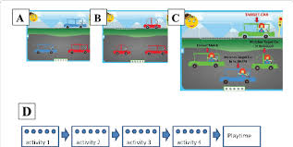
Difficulty of puzzles
Organise the puzzles by increasing difficulty
Or
Alternate a simple puzzle with a more complex one
https://www.researchgate.net/figure/Examples-of-puzzles-with-increasing-complexity-a-A-child-must-notice-one-cue-color_fig1_323923945

Slide 5
Number of clues
Hide the clues carefully - important clues can be hidden in a simple hiding place; optional clues can be hidden better
Link between clues and puzzles
A clue belongs to a riddle
Find a good balance between the clues and the puzzles

Slide 6
Guidance of the teacher
Give hints on request
or
When you think they are needed
Implement a way for students to position themselves in the advancement of the activity
https://www.pinterest.com/pin/569072102888745208/
https://roomescapeartist.com/2017/01/22/spin-masters-escape-room-the-game-review/escape-room-the-game-hints-3/

