Slide 1
GRAIN 2
Determine the learner styles of participants

Slide 2
Who are your students?
How would you characterise the students you are teaching?
Do you think students study differently these days because of social media?
wolpert-gawron-169hero-onlinemgmt-shutterstock
https://campusmonita.com/class-management/

Slide 3
How students learn
There are many ways that students learn, and they have multiple and varying needs. Accordingly, these needs of students are influenced by their personalities. This is because students:
• Learn in different ways
• Learn at a different pace
• Have different backgrounds
• Have different reasons for learning
• Are motivated in different ways and by different things
• Respond differently to challenges

Slide 4
Learning styles
Crystal Joy Crystal Joy saved to Creators Creative Expressions
learning styles | Print off this "Learning Styles" chart! What is YOUR Learning Style?
https://www.pinterest.com/pin/133419207684305340/
https://sites.google.com/site/aclassroomforrainbowkids/websites

Slide 5
Visual learner
Understand your child’s learning style
https://www.tatasky.com/dth/services/kids/class-room
https://phonics101.wordpress.com/learning-styles/learning-style-visual/

Slide 6
Auditory learner
Understand your child’s learning style
https://www.tatasky.com/dth/services/kids/class-room
https://phonics101.wordpress.com/learning-styles/learning-style-visual

Slide 7
Verbal learner
Learning Strategies for the Visual/Verbal Learner:
Use colour coding, when studying new information in text or notes
Use highlighter to highlight different kinds of information in contrasting colors
Make flashcards- limiting information on each card
Write out explanations for diagrams or illustrations
Write out in detail how to do steps in mathematical or technical problem solving
Before an exam/test use post-it notes with key words and place in highly visible spots, mirror, dashboard etc.
curriculum clipart linguistic intelligence 2578087
https://webstockreview.net/image/curriculum-clipart-linguistic-intelligence/2578087.html

Slide 8
Physical learner
Tactile/Kinesthetic Learners
0pportunities to move and handle materials
Trace and highlight
Act out concepts and stories
Role playing models
Write or draw while listening
Walk while thinking
Use hands and arms for expression
Imagine themselves in a situation
Simulate Dance or mime Perform
Create, construct, or develop
You Are a Kinesthetic Learner
Here are Your Super-Powers!
https://www.howtolearn.com/kinesthetic-learner/

Slide 9
Logical learner
If you use the logical style, you like using your brain for logical and mathematical reasoning.
You can recognize patterns easily, as well as connections between seemingly meaningless content.
This also leads you to classify and group information to help you learn or understand it.
Understand your child’s learning style
https://www.tatasky.com/dth/services/kids/class-room

Slide 10
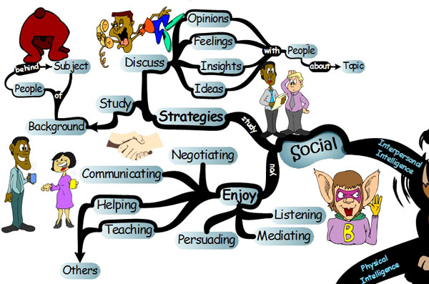
Social Learner
Understand your child’s learning style
https://www.tatasky.com/dth/services/kids/class-room
https://medium.com/@rebekahamaro/learning-styles-the-importance-of-critical-self-reflection-tesia-marshik-tedxuwlacrosse-5f271ec3ff

Slide 11
Solitary learner
Tend to be more private and independent.
Able to concentrate well on current topics.
Aware of own feelings and thinking.
Take time to think about current challenges and accomplishments.
Learning techniques- create personal interest in topics, keep a journal, assertions, and modeling.
Understand your child’s learning style
https://www.tatasky.com/dth/services/kids/class-room

