Slide 1
GRAINS 22-24
Introduction to technical props:
The use of instructional video, augmented reality and immersive video in the development of your ER

Slide 2
Technical props
Video finds its place in pedagogy as a support for creation and a tool for expression.
Augmented reality makes it possible to make all images "digitizable" and to associate an action to it in order to make it richer in information.
In front of an immersive video (360°), the user is involved and engaged in a virtual reality experience.

Slide 3
The instructional video
The video has been inserted into the set of teachings as a learning support that allows to visualize an experience, a phenomenon, a process.
The criteria of the instructional video
Using instructional video in an ER
The concepts covered in the video must be explicit.
The pedagogical intent must be clear
The student should not have to look for what he or she is looking at.
Teaser the mission in which the students will participate
Announce the mission to the students
Add more information
Associate a riddle, a helper, a clue

Slide 4
Augmented reality
RA mixes virtual and real worlds, in 2D or 3D, which enrich reality by superimposing additional information.
Marker based
Projection based
Also called image recognition, uses a camera and a visual marker (QR code, barcode, simple patterns) to show the result.
Works by projecting features onto real-world surfaces and objects, detecting and reacting to human interaction.
Location based
Surimposition based
Uses a smartphone's built-in GPS and sensors such as a compass and accelerometer to locate virtual features. It is commonly used in applications that contain location information.
Replaces the original view entirely or partially with an augmented view. It works by object recognition, so that it can replace or add to any virtual object.

Slide 5
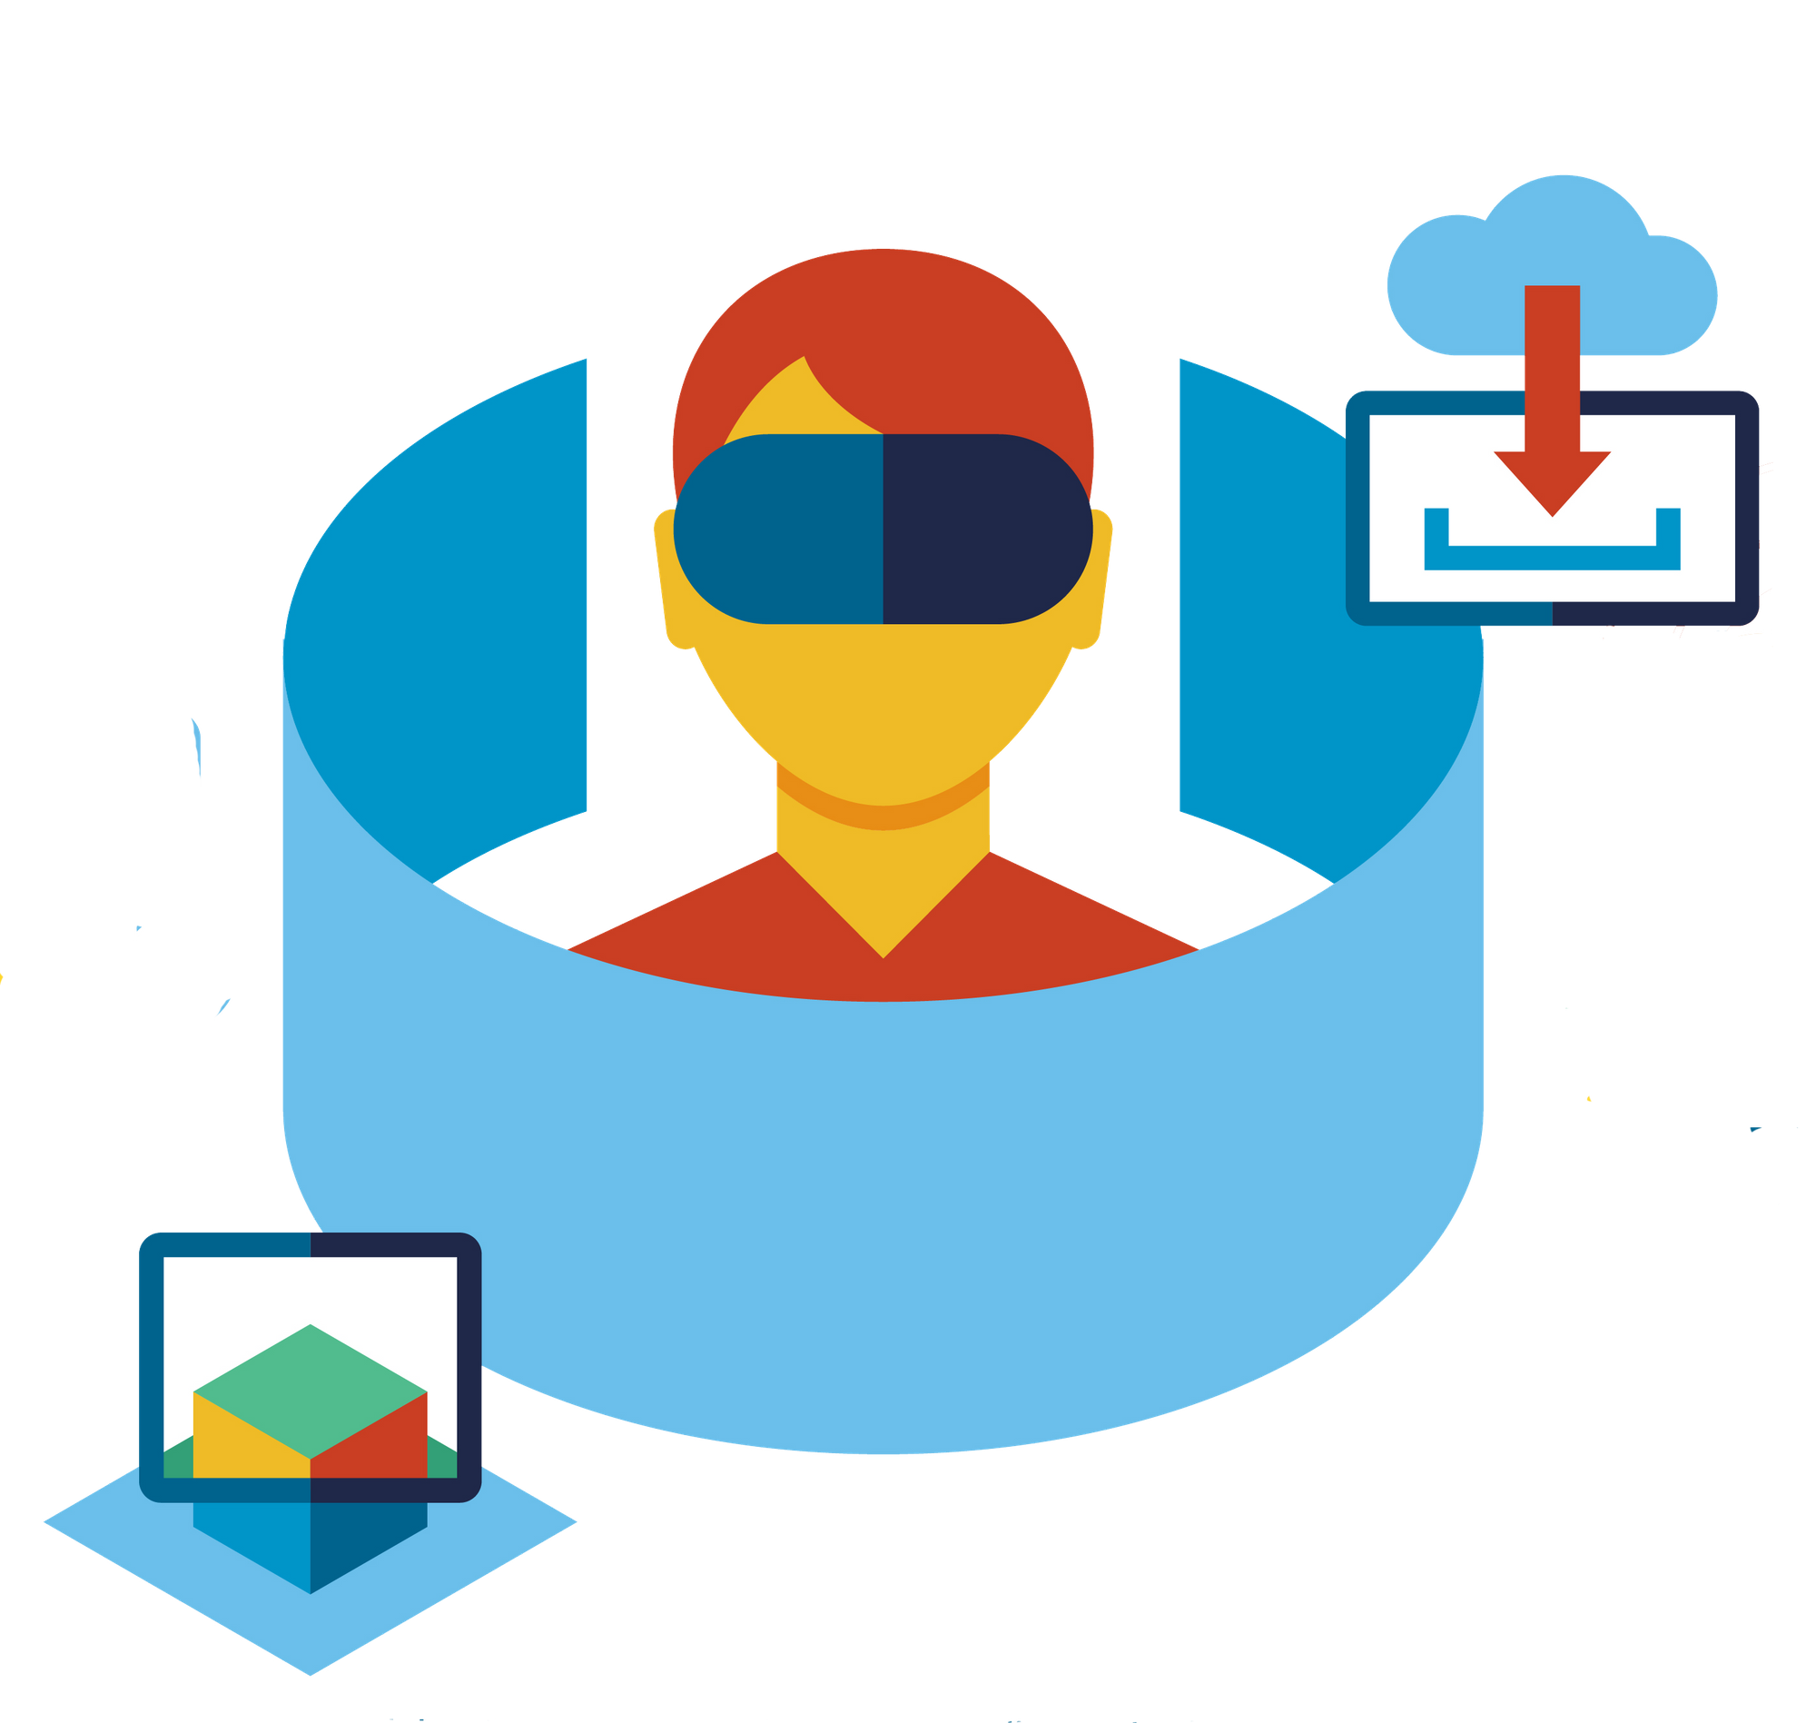
Immersive video (vidéo 360°)
Allows you to record videos of a real world scene in all directions at the same time.
Taking the user into account
The importance of technique and consistency
The viewer is "placed" in the centre of the video and can look in all directions.
When projecting the video, the user controls the direction in which he or she looks at the scene.
The different parts must be assembled in such a way as to make them homogeneous by adjusting the colours, light and contrast of each video.
The assembly of the sound part is particularly important.

