Slide 1
GRAIN 12
Introduction to the theory of Escape Room Puzzles

Slide 2
Lock type puzzle

Slide 3
Code type puzzle
Caesar cipher

Slide 4
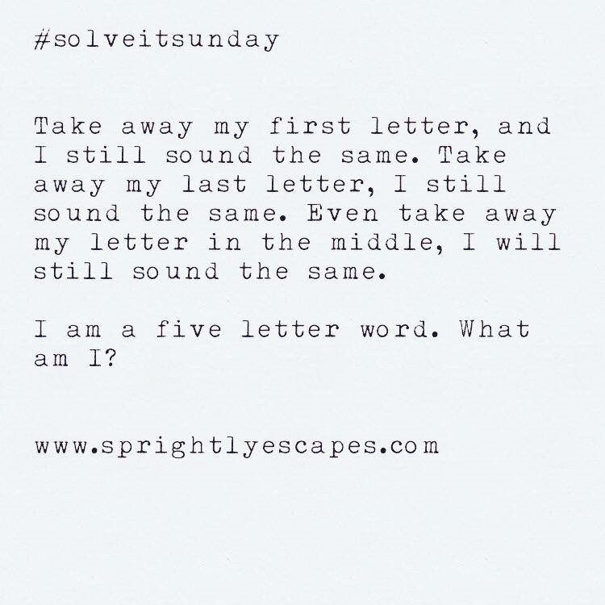
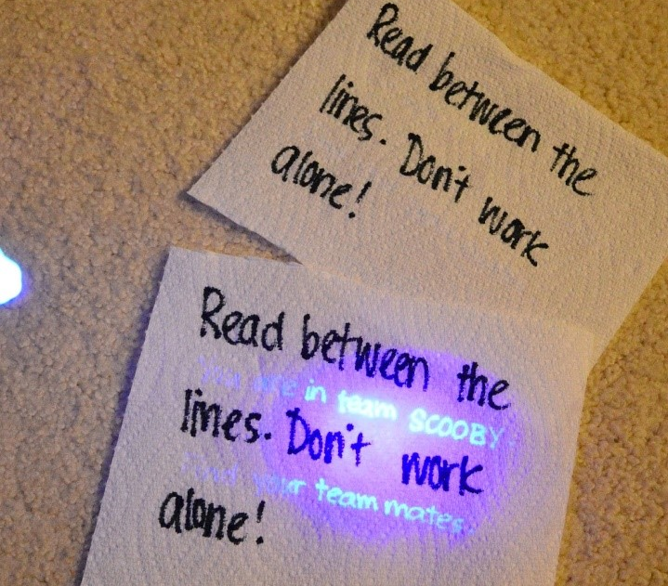
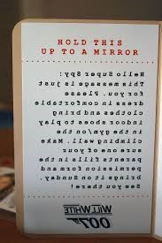
Written puzzles
Riddles
Blacklight
Crossword
Reversed Text

Slide 5
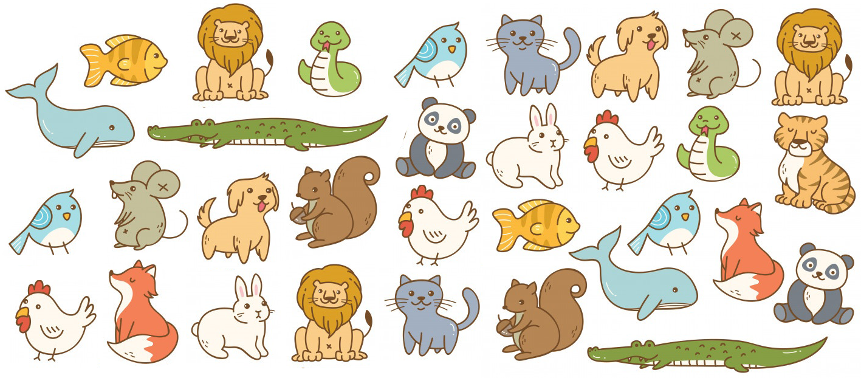
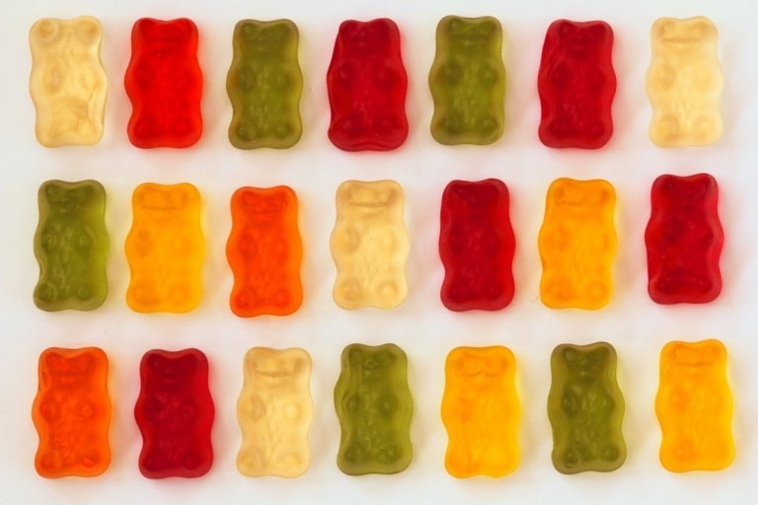
Puzzles based on patterns
Animals count : 2 foxes, 3 birds, 1 tiger, 2 rabbits. Combine that with a hint elsewhere of « Fox, Bird, Tiger, Rabbit ». The code is 2312.
Gummy bear count: 6 red, 2 orange, 4 yellow, 5 green, and 4 white. Combine that with a hint elsewhere of “Red Orange Yellow Green” gummy bears leads to a code of 6245

Slide 6
Mathematical puzzle
16
32
72
?

Slide 7
References
Slide 2
Locks: Holt Vincent (2019), Game Title. Game Title Story This is where you would post the story for your game. Your story should explain why there is a locked box in the room. Presentation, SlidePlayer, slide 9. Retrieved from: https://slideplayer.com/slide/13967467/
Slide 3:
Caesar cipher: Lock Paper Scissors (2020). 13 Escape Room Cipher Ideas That Encode Mystery & Mayhem. Retrieved from: https://lockpaperscissors.co/ciphers-playbook
Codes: Puzzled Pint (2016), Code Sheet. Retrieved from: http://www.puzzledpint.com/files/3614/6881/3541/CodeSheet_07_2016.pdf.
Slide 4:
Riddle: Sprightly Escapes (2016). Best Denver Team-Building: Escape Rooms ! Retrieved from : https://www.sprightlyescapes.com/sprightlyshenanigans/2016/12/18/denver-team-building-escape-rooms.
Blacklight: Ikatbag (2014). Mystery Party: Clues & Evidence. Retrieved from: http://www.ikatbag.com/2014/10/mystery-party-clues-evidence.html?m=1
Crossword: Planet Source Code (2015). Crossword puzzle generator. Retrieved from: http://www.planetsourcecode.com/vb/scripts/ShowCode.asp?txtCodeId=66595&lngWId=1Reversed Text: Pinterest (2020), “Breakout clues, ciphers, riddles and helps”. Available at: https://www.pinterest.com/pin/1548181108669408/
Slide 5:
Animals pattern: Created using Doodlebarn (2019). Ensemble d’animaux de dessin animés. Retrieved from: https://fr.freepik.com/vecteurs-premium/ensemble-animal-dessin-anime_4309616.htm
Gummy Bears Pattern: Escape Room Tips (2020). Top 11 puzzle ideas for Escape Rooms. Retrieved from: https://escaperoomtips.com/design/escape-room-puzzle-ideas
The European Commission support for the production of this publication does not constitute an endorsement of the contents which reflects the views only of the authors, and the Commission cannot be held responsible for any use which may be made of the information contained therein.
GRAIN 12

